Slide 2

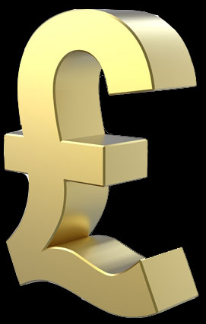
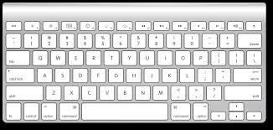

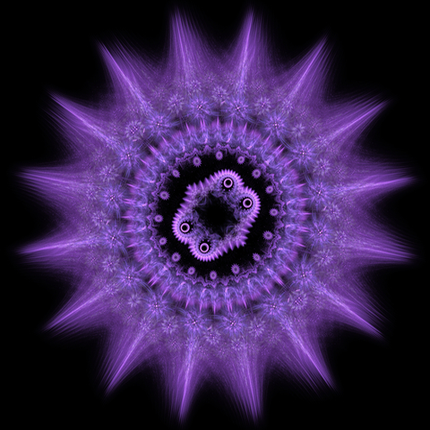




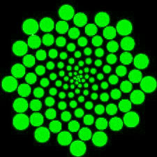


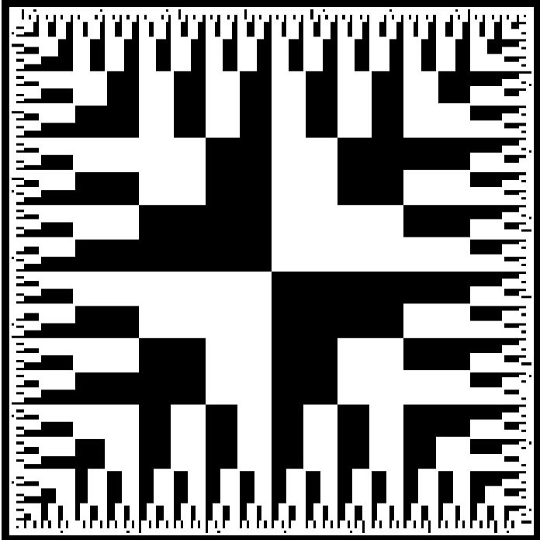

2 seconds
Wait 1 seconds
2 seconds
2 seconds

Slide 3
The Game…
Practice session:
2 seconds
Wait 1 seconds
2 seconds
2 seconds

Slide 4
The Game…
Practice session:
2 seconds
15 trials (training)
15 trials (training)
Wait 1 seconds
2 seconds
2 seconds

Slide 5
The Game…
Practice session:
2 seconds
15 trials (training)
15 trials (training)
Wait 1 seconds
30 trials (Money collection)
2 seconds
Game session:
2 seconds

Slide 6
The Game…
Practice session:
2 seconds
15 trials (training)
?
?
?
?
15 trials (training)
Wait 1 seconds
30 trials (Money collection)
?
?
?
?
2 seconds
Game session:
?
?
2 seconds

Slide 7
The Game…
Practice session:
2 seconds
15 trials (training)
?
?
?
?
15 trials (training)
Wait 1 seconds
30 trials (Money collection)
?
?
?
?
2 seconds
Game session:
20 trials (training)
40 trials (training)
?
?
2 seconds

Slide 8
The Game…
Practice session:
2 seconds
15 trials (training)
?
?
?
?
15 trials (training)
Wait 1 seconds
30 trials (Money collection)
?
?
?
?
2 seconds
Game session:
20 trials (training)
40 trials (training)
?
?
2 seconds
350 trials (Money collection)

Slide 9

